Slide 1
Point Pattern Analysis
Lectures

Slide 2
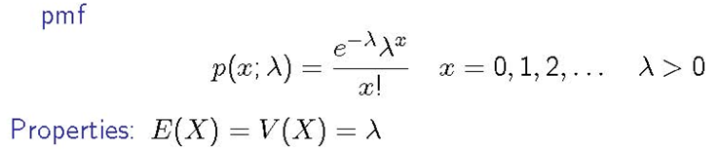
A Review: Poisson Distribution
(See https://www.youtube.com/watch?v=65n_v92JZeE for proof)
The value of λ is often a rate per unit time or rate per unit area.
You will see the Poisson Distribution when you do point pattern analysis.
Notes:
E(X) = V(X) = λ: Equidispersion

Slide 3
Poisson Distribution – An Example
Let X denote the number of deer sighted by a Yellowstone park ranger on a given day. Suppose that X has a Poisson distribution with λ = 4.5. Since λ is the expected value of the Poisson rv, on average, the number of deer seen per day will be 4.5. What is the probability that on a randomly chosen day, the ranger will have seen exactly 5 deer when λ = 4.5?
Answer:
This can be done in Excel. Enter: ‘=POISSON(x, λ,FALSE)’
Here: =POISSON(5,4.5,FALSE) yields 0.1708

Slide 4
Poisson Process and Observing Events Over a Region
Poisson Distribution – Another Example
Instead of observing events over time, consider observing events that occur in a region.
E.g., Select some region R of a forest in a map, go to that region, and count the number of trees. Each tree would represent an event occurring at a particular point in space.
The number of events occurring in region R has a Poisson distribution with parameter λ = α ∙ area (R).
Here, α is the expected number of events in a unit area.

Slide 5
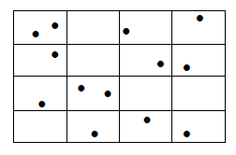
Poisson Process - Example
Poisson Distribution – Another Example (Cont’d)
Suppose that on average, there are 0.81 trees in a 1 square meter region R of a [very dense] forest. That is, λ = α ∙ area (R) = 0.81 ∙ 1 = 0.81 trees per square meter. Then, the probability of seeing exactly one tree in a square meter region is:
In Excel: ‘=POISSON(1,0.81,FALSE)’
Assume each of these little rectangular regions is R. Area (R)=1

Slide 6
Point Pattern Analysis - Outline
CSR
Quadrat Method
Nearest Neighbor
Ripley’s K Function
Different scales
Border effects
Population weights

Slide 7
Point Pattern Analysis
In this section of the course, we will examine spatial point processes
We will use several statistical methods to try to determine whether the points are clustered, dispersed, or randomly distributed in space
Here, we will focus on where the points are located, not the values at the points.
That is, a point represents an ‘event’, an ‘incident’ or an ‘occurrence’ of a phenomenon at a location
A lack of a point represents a lack of an event at that location.

Slide 8
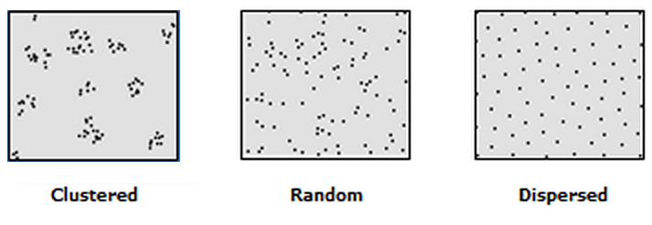
3 Possible Point Patterns
Crimes might be concentrated in certain areas of a city
Oaks in a park might be randomly distributed
Wolf packs might be dispersed within a forest (aka, evenly or uniformly distributed)
In the figures below, a point might represent a crime, an oak, or a wolf pack (1 point per incident)

Slide 9
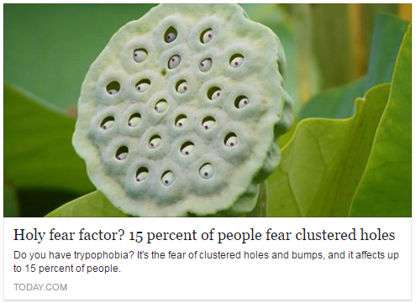
(With Apologies to Trypophobes!)
Source: http://www.today.com/video/holy-fear-factor-15-percent-of-people-fear-clustered-holes-502007875933?cid=sm_fbn

Slide 10
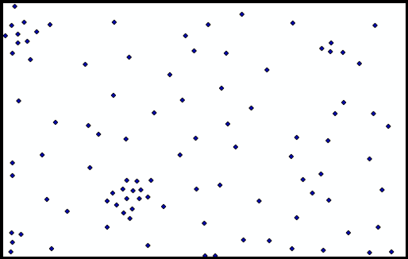
Motivating Example
Assume that we’re dealing with a point process in a region R
Here, let the points represent the number of assaults in a region of Portland, OR [the data is made up]
Question: Are the points clustered, random, or dispersed, and to what extent?
R

Slide 11
Sometimes It’s Not Visually Obvious
We need some sort of a measure characterizing a point process
We’ll talk about a few!

Slide 12
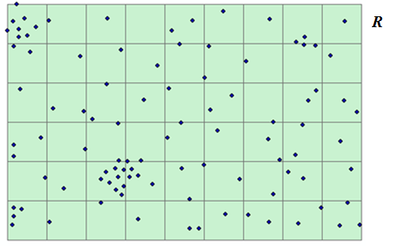
Let’s Start by Defining What We Mean by Random
For the sake of example, let’s subdivide the region R into a lattice containing bunch of square cells (quadrats) of equal size, as below. In the example below there are 54 cells of equal area.
A point process is completely spatially random (CSR) if:
The probability that a point lands in any of the cells is directly proportional to the area of the cell. If you have equally sized cells, a point is equally likely to land in any cell.
In this example, all cells have equal area (1/54th of R), so landing in any of the 54 cells is equally likely for a point.
This is the case for all the points (100 in our example)
Where one point lands has no effect on where any of the other points land. That is, the location of point i is independent of the location of point j.
Notes:
Cards Example

Slide 13

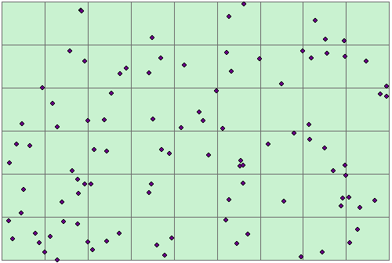
Confused? Let’s Generate a Random Spatial Process!
Let’s say we want to generate 100 points.
2 3 4 5 6 7 8 9
R
10 11 12 13 14 15 16 17 18
19 20 21 22 23 24 25 26 27
28 29 30 31 32 33 34 35 36
37 38 39 40 41 42 43 44 45
46 47 48 49 50 51 52 53 54
Label cells Generate random points
1. For this particular example, take a standard deck of cards (52 conventional cards and 2 jokers, for a total of 54 cards).
2. Number the cards from 1 to 54 – write the number on the back of each card.
3. Shuffle the deck.
4. Pick a random card from the deck. Look at the number. Put a point in the cell to which the number corresponds. For instance, if card # 28 is picked, put a point in cell 28 above (figure on the left).
5. Put the card back in the deck.
6. Repeat steps 3-5 above 99 times, until all 100 points are generated (figure on the right).

Slide 14
What Happens if the Point Process is Clustered or Dispersed?
Condition 2 of the CSR is not met (and possibly condition 1). That is, the location of point i is NOT independent of the location of point j.
When you have clustering, points will land close to each other
When you have dispersion, points will land at regular intervals apart from each other

Slide 15
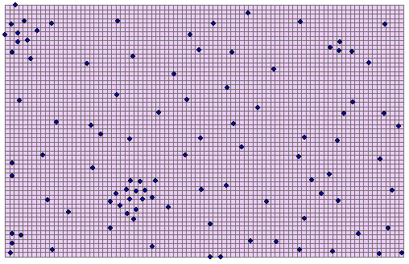
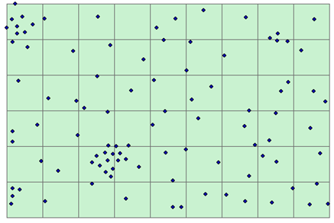
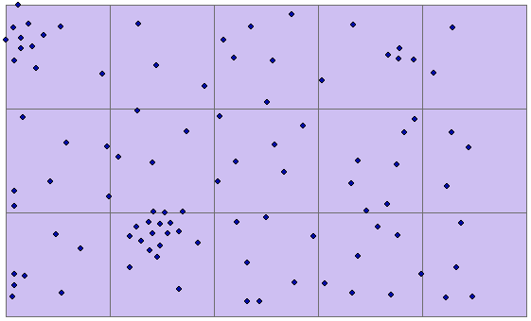
Many cells contain no points
There’s variability in # of points per cell
Similar # of points per cell
Quadrat Method
In the problem at hand, we split our region R into 54 cells (quadrats). But we could have split it into many more or many fewer cells. MODIFIABLE AREAL UNIT PROBLEM
The number of cells will affect what kind of pattern we identify (random, clustered, dispersed)
Obvious question: What cell (quadrat) size should we use?
Same point pattern; Different quadrat (i.e., cell) side length.
Top (27.4 ft)
Middle (274 ft)
Bottom (548 ft)

Slide 16
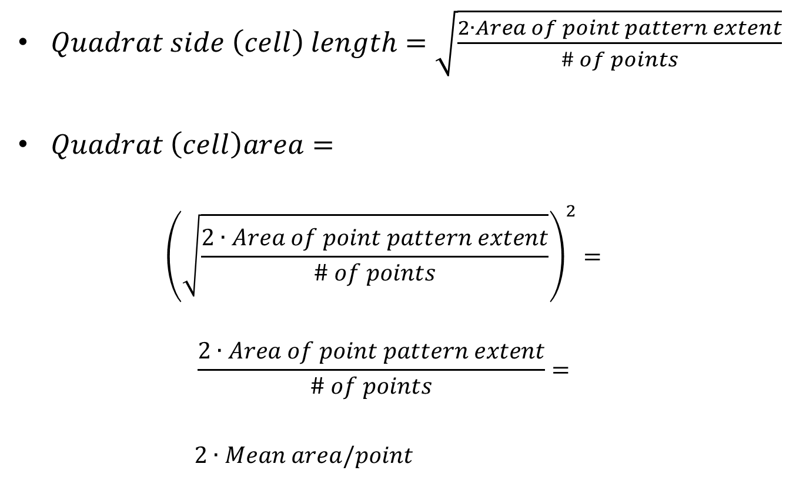
Quadrat Size Suggested in the Literature
$Quadrat side \left(cell\right) length=\sqrt{\frac{2∙Area of point pattern extent}{\# of points}}$
$Quadrat \left(cell\right)area=$
$${\left(\sqrt{\frac{2∙Area of point pattern extent}{\# of points}}\right)}^{2}=$$
$$\frac{2∙Area of point pattern extent}{\# of points}=$$
$2∙Mean area/point$

Slide 17
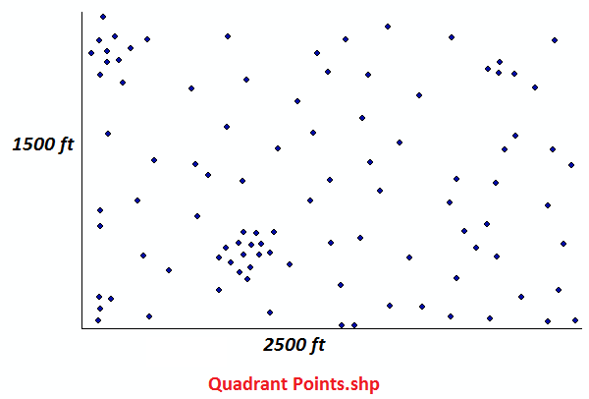
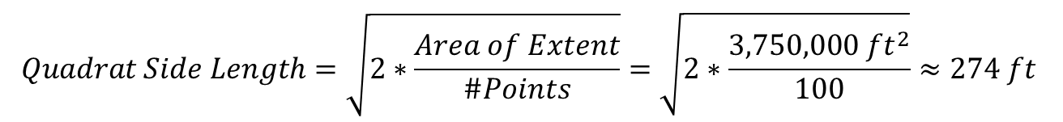
Quadrat Size - Back to Our Example
N = 100 points
Area of extent =
1500 ft * 2500 ft = 3,750,000 ft²
$$Quadrat Side Length=\sqrt{2∗\frac{Area of Extent}{\#Points}}=\sqrt{2∗\frac{3,750,000 {ft}^{2}}{100}}≈274 ft$$

Slide 18
Doing it with GIS: Try the Geospatial Modeling Environment (GSM)
Download GSM, formerly known as Hawth’s Tools, from:
http://www.spatialecology.com/gme/gmedownload.htm
Follow instructions on the page to download the appropriate version
GSM depends on ArcGIS (version 10 or higher) and GSM has some excellent functions which are described in detail here:
http://www.spatialecology.com/gme/gmecommands.htm
The command that we’re interested in is GenVecGrid, which creates a square lattice

Slide 19
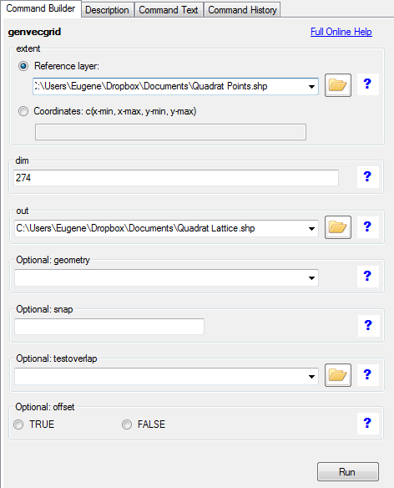
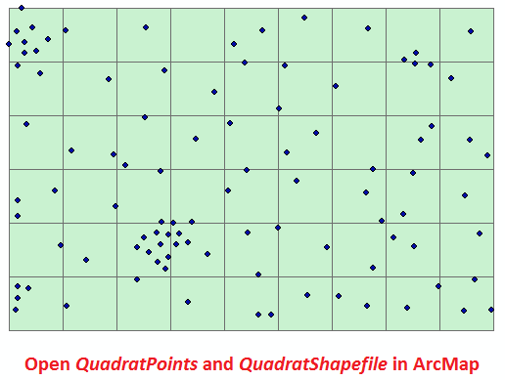
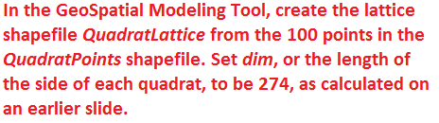
GenVecGrid Command Output,
Displayed in ArcGIS

Slide 20
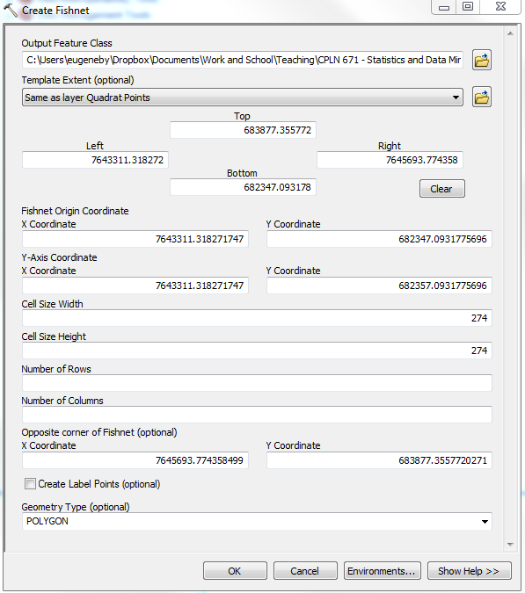

Alternatively, Use ArcGIS to Create Fishnet

Slide 21
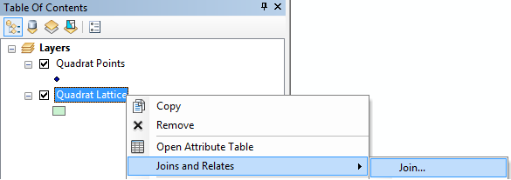
Let’s Calculate # Points/Cell in ArcMap
Right click on Quadrat Lattice Layer
in ArcMap, select ‘Joins and Relates’,
click on ‘Join’
Crime points
Lattice with 54 cells

Slide 22
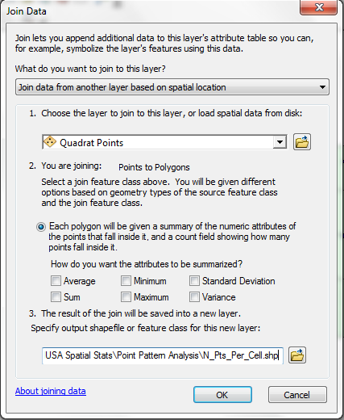
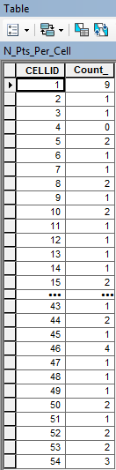
# of Points Per Cell in ArcMap
The attribute table of N_Pts_Per_Cell shows the # of points per cell (quadrat)

Slide 23
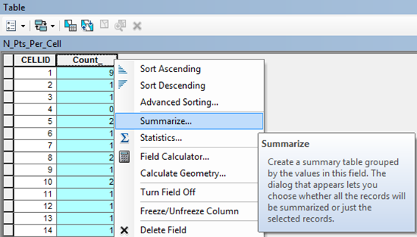
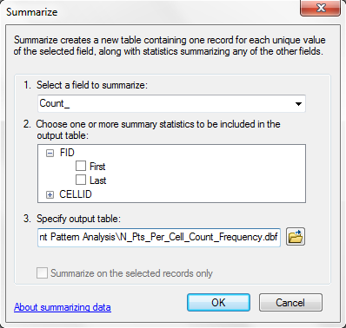
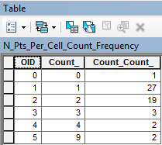
Summarize in ArcMap
Table N_Pts_Per_Cell_Count_Frequency
Count_: # of points per cell (quadrat)
Count_Count_: # of cells (quadrats) that have Count_ points in them

Slide 24
Now, Let’s Do Some Stats in MS Excel
Open MS Excel
Navigate to the N_Pts_Per_Cell_Count_Frequency.dbf file and open it.
Rename the field Count_ to x (# of points per cell)
Rename the field Count_Count to Frequency (# of cells with x points in them)

Slide 25

Setting it Up in Excel
Field formerly known as Count_ Here known as x (Observed Number of Points Per Quadrat) | Field formerly known as Count_Count_ Here known as Frequency (Observed Number of Quadrats with Such a # of Points) |  | Total Points (x*Freq) | Observed Prop | Expected Prop | Expected Number of quadrats with x points | Expected Cumulat. Proportion Ce | Observed Cumulat. Prop. Co | |Difference Between Expected and Observed Cumulative Proportions|
0 | 1 |  | 0 | 0.02 | 0.1569 | 8.4751 | 0.1569 | 0.02 | 0.1384
1 | 27 |  | 27 | 0.50 | 0.2906 | 15.6946 | 0.4476 | 0.52 | 0.0709
2 | 19 |  | 38 | 0.35 | 0.2691 | 14.5321 | 0.7167 | 0.87 | 0.1537
3 | 3 |  | 9 | 0.06 | 0.1661 | 8.9704 | 0.8828 | 0.93 | 0.0431
4 | 2 |  | 8 | 0.04 | 0.0769 | 4.1530 | 0.9597 | 0.96 | 0.0032
5 | 0 |  | 0 | 0.00 | 0.0285 | 1.5381 | 0.9882 | 0.96 | 0.0252
6 | 0 |  | 0 | 0.00 | 0.0088 | 0.4747 | 0.9970 | 0.96 | 0.0340
7 | 0 |  | 0 | 0.00 | 0.0023 | 0.1256 | 0.9993 | 0.96 | 0.0364
8 | 0 |  | 0 | 0.00 | 0.0005 | 0.0291 | 0.9999 | 0.96 | 0.0369
9 | 2 |  | 18 | 0.04 | 0.0001 | 0.0060 | 1.0000 | 1.00 | 0.0000
10 | 0 |  | 0 | 0.00 | 0.0000 | 0.0011 | 1.0000 | 1.00 | 0.0000
There are 0 quadrats with these x's, but we can still put them in (or not).
n (# points) |  | 100
ν (# quadrats) |  | 54
λ (# points/#quadrats = n/ν) |  | 1.851851852
Largest Absolute Difference |  | 0.153670664
Critical Kolmogorov Smirnov Test Value |  | 0.185072558
$$P\left(X\right)=\frac{e^{−λ}λ^{x}}{x!}$$
Notes:
Go through Excel File, then discuss K-S Test

Slide 26
Kolmogorov-Smirnov (K-S) Test
The method compares an observed set of frequencies to a theoretical frequency distribution.
In the case of quadrat analysis of point pattern, we test the fit of our observed set of point pattern frequency in quadrats against the random Poisson frequency distribution.
H0: the pattern is random (the observed frequency is of the random Poisson frequency)
Ha: the pattern is NOT random (the observed point pattern frequency is not the random Poisson frequency)
Does not really distinguish between dispersion and clustering – just random vs. NOT random. To determine whether it’s dispersed or clustered, just look at the pattern if the test shows that the points are NOT random.

Slide 27
Kolmogorov-Smirnov Test Statistic
The test statistic is the largest absolute difference, D, given as D = |Co - Ce| where Co and Ce are the observed and expected cumulative proportions for each value of x (Show in Excel)
The computed test statistic D is compared to the critical value of D obtained from a special Kolmogorov-Smirnov table.
The value of the critical value depends on the level of significance, α (0.05 for us), and degrees of freedom, ν.
Here, the degrees of freedom, ν is the sum of the observed frequencies (# of quadrats).

Slide 28
Kolmogorov-Smirnov Test in Practice
K-S Critical Values
 |  | α
 |  | 0.01 | 0.05 | 0.1
ν (# of quadrats) | 1 | 0.995 | 0.975 | 0.95
 | 2 | 0.929 | 0.842 | 0.776
 | 3 | 0.828 | 0.708 | 0.642
 | 4 | 0.733 | 0.624 | 0.564
 | 5 | 0.669 | 0.565 | 0.51
 | 6 | 0.618 | 0.521 | 0.47
 | 7 | 0.577 | 0.486 | 0.438
 | 8 | 0.543 | 0.457 | 0.411
 | 9 | 0.514 | 0.432 | 0.388
 | 10 | 0.48 | 0.41 | 0.368
 | 11 | 0.468 | 0.391 | 0.352
 | 12 | 0.45 | 0.375 | 0.338
 | 13 | 0.433 | 0.361 | 0.325
 | 14 | 0.418 | 0.349 | 0.314
 | 15 | 0.404 | 0.338 | 0.304
 | 16 | 0.392 | 0.328 | 0.295
 | 17 | 0.381 | 0.318 | 0.286
 | 18 | 0.371 | 0.309 | 0.278
 | 19 | 0.363 | 0.301 | 0.272
 | 20 | 0.356 | 0.294 | 0.264
 | 25 | 0.32 | 0.27 | 0.24
 | 30 | 0.29 | 0.24 | 0.22
 | 35 | 0.27 | 0.23 | 0.21
 | 40 | 0.25 | 0.21 | 0.19
 | 45 | 0.24 | 0.2 | 0.18
 | 50 | 0.23 | 0.19 | 0.17
 | 51+ | 1.63/ sqrt(ν) | 1.36/ sqrt(ν) | 1.22/ sqrt(ν)
Recall:
H0: the pattern is random; Ha: the pattern is NOT random
Test procedure:
1. Using the table to the left, calculate the critical value. In our case, we have 54 quadrats, meaning that ν = 54 > 50. When α = 0.05, the critical value is 1.36/sqrt(ν) = 1.36/sqrt(54) = 0.185. (Show in Excel)
2. Calculate the largest absolute difference D as on slide 20 (last 3 columns). Basically, subtract the observed cumulative proportion from the expected cumulative proportion, take the absolute value of the differences, and find the maximum value. In our case, the largest absolute difference D is 0.1537 (when the observed number of points per cell is 2) (Show in Excel)
3. Compare the result in 1 to the result in 2 above (i.e., compare the critical value to the largest absolute difference.
-- If the critical value is larger than the calculated largest absolute difference, fail to reject H0 for Ha.
-- If the critical value is smaller than the calculated largest absolute difference, reject H0 for Ha.
Here: Critical value = 0.185 > largest absolute difference D = 0.1537.
So we fail to reject H0 for Ha, meaning that we cannot say that we observe a pattern that’s significantly different from a random one.

Slide 29
Doing it with R
#LOAD THE FOLLOWING PACKAGES THE FIRST TIME YOU USE R:
install.packages("ISLR")
install.packages("sp")
install.packages("MASS")
install.packages("spatstat")
install.packages("spatial")
install.packages("maptools")
install.packages("ppp")
install.packages("fossil")
install.packages("adehabitatHR")
install.packages("gdata")
install.packages("raster")
install.packages("rgdal")
install.packages("geostatsp")
library(graphics)
library(maptools)
library(spatstat)
library(sp)
library(fossil)
library(spatial)
library(adehabitatHR)
library(gdata)
library(raster)
library(rgdal)
library(geostatsp)
#Setting working directory
setwd("C:/CPLN 671 - Statistics and Data Mining/Point Pattern Analysis")

Slide 30
Doing it with R (Cont’d)
#Reading Polygon Boundary.shp file
Boundary <- readShapePoly("Boundary.shp")
#Class "SpatialPolygons" holds polygon topology (without attributes)
BoundaryPolygons <- as(Boundary, "SpatialPolygons")
#The class "owin" is a way of specifying the observation window for a point pattern.
BoundaryPolygonsOW<- as(BoundaryPolygons, "owin")
#Plotting the Boundary Window
plot(BoundaryPolygonsOW)
title(main = "Point Pattern Analysis")
#Reading in the file with the points (point locations have been slightly edited from GPS shapefile)
Pts <- read.table("Quadrat Points.txt", header=T, sep="\t", colClasses = c("X"="double"))
pp <- ppp(Pts$X, Pts$Y, window=BoundaryPolygonsOW)
#Now let's plot the points and the Boundary.
plot(pp)
title(main = "Point Pattern Analysis")
#In the slides, we figured out that the approximate length of each quadrat (cell) should be #274 ft. This implies that we can get 9 quadrats in the horizontal direction and 6 in the vertical (we can measure the width and length of the boundary and see that this is true.)
q <- quadratcount(pp, 9,6)
plot(q)
plot(pp, add=T)
quadrat.test(pp, 9, 6)
qmatrix <-table(q)

Slide 31
Doing it with R (Cont’d)
#x is the observed number of points per quadrat
x <- matrix(as.numeric(rownames(qmatrix)))
#frequency is the number of times each observed number of points per quadrat appears
frequency <-matrix(t(qmatrix))
#Total points (i.e., how many total points are there in all quadrats with x points)
totalpoints <-x*frequency
#Observed proportion of all quadrats containing x points. Here, 54 is the number of quadrats.
obsprop <-frequency/54
#Expected proportion of all quadrats containing x points under CSR. This is simply the Poisson CMF with lambda = 100/54.
expprop <- exp(-100/54)*((100/54)^x)/factorial(x)
#Cumulative proportions
#cumsum is a convenient command which does a cumulative (i.e., running) sums of all previous entries
obscumprop <-cumsum(obsprop)
#This is the Poisson CMF. Here, 100 is the number of points and 54 is the number of quadrats.
expcumprop <-ppois(x, lambda=(100/54))
#Absolute difference between expected and observed cumulative proportions. Notice that the maximum cumdiff value is the same as in Excel, 0.1537.
cumdiff <- round(abs(expcumprop-obscumprop),4)
dataset <-cbind(x,frequency,totalpoints,obsprop, expprop,obscumprop,expcumprop,cumdiff)
#Again, compare maximum discrepancy between observed and expected cumulative proportions, (.1537) to the critical value we get in the slides (here, 1.36/sqrt(v) = 1.36/sqrt(54))

Slide 32
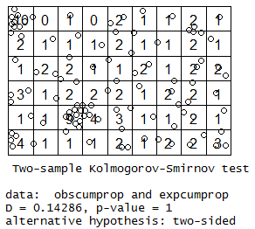
Results
Notice: in R, the lattice is a little bit shifted compared to one generated in ArcGIS, resulting in different counts per quadrat, and slightly different results.

Slide 33
The VMR: Variance-Mean Ratio
Variance Mean Ratio (VMR)
Variance of the # of points per cell divided by the average of the # of points per cell
VMR = VAR(#)/MEAN(#)
When…
VMR = 1 indicates we have a random pattern
Mean = Variance = λ, so mean/variance = 1
This is what happens when the observed frequency of points per cell is equal to the expected frequency of points per cell (under Poisson)
VMR < 1 indicates uniformity (dispersion)
Variance < Mean.
That is, there is little variability in the number of points per cell
Variance = 0 indicates perfect uniformity, because it means that there is no variability in the # of points per cell
VMR > 1 indicates clustering
There is great variability in the number of points per cell. Some may have only a few, and others may have many (i.e., clustering)

Slide 34
Random
Uniform
Clustered
RANDOM
UNIFORM/
DISPERSED
CLUSTERED
Note:
ν = number of Quadrats = 10
VMR = Variance/mean

Slide 35
Significance Tests for VMR
They exist. However, we won’t get into them, because the quadrat method has a number of limitations.
These limitations are presented on the next slide.
Limitations are serious enough that they deserve looking into another method.

Slide 36
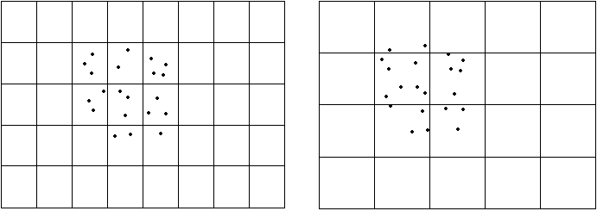
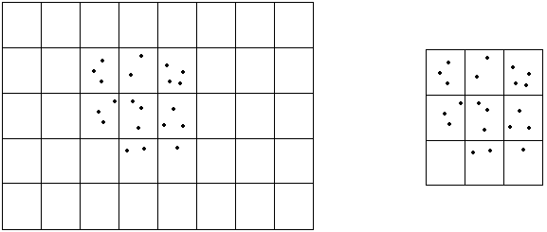
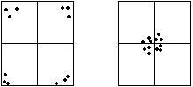
Some Issues with Quadrat Analysis
Same pattern; same range; different cell size =>
Different Results
Same pattern; same cell size; different range =>
Different Results
Same range; same cell size, same number of points in each cell; different pattern =>
Same Results
a.
b.
c.

Slide 37
Summarizing
The quadrat method is a measure of point density, since we’re counting the number of points per unit area (i.e., quadrat or cell)
We aren’t taking into consideration how far apart the points are, and how they’re arranged in space.
This is a pretty big limitation and we should look at other point pattern methods.

Slide 38
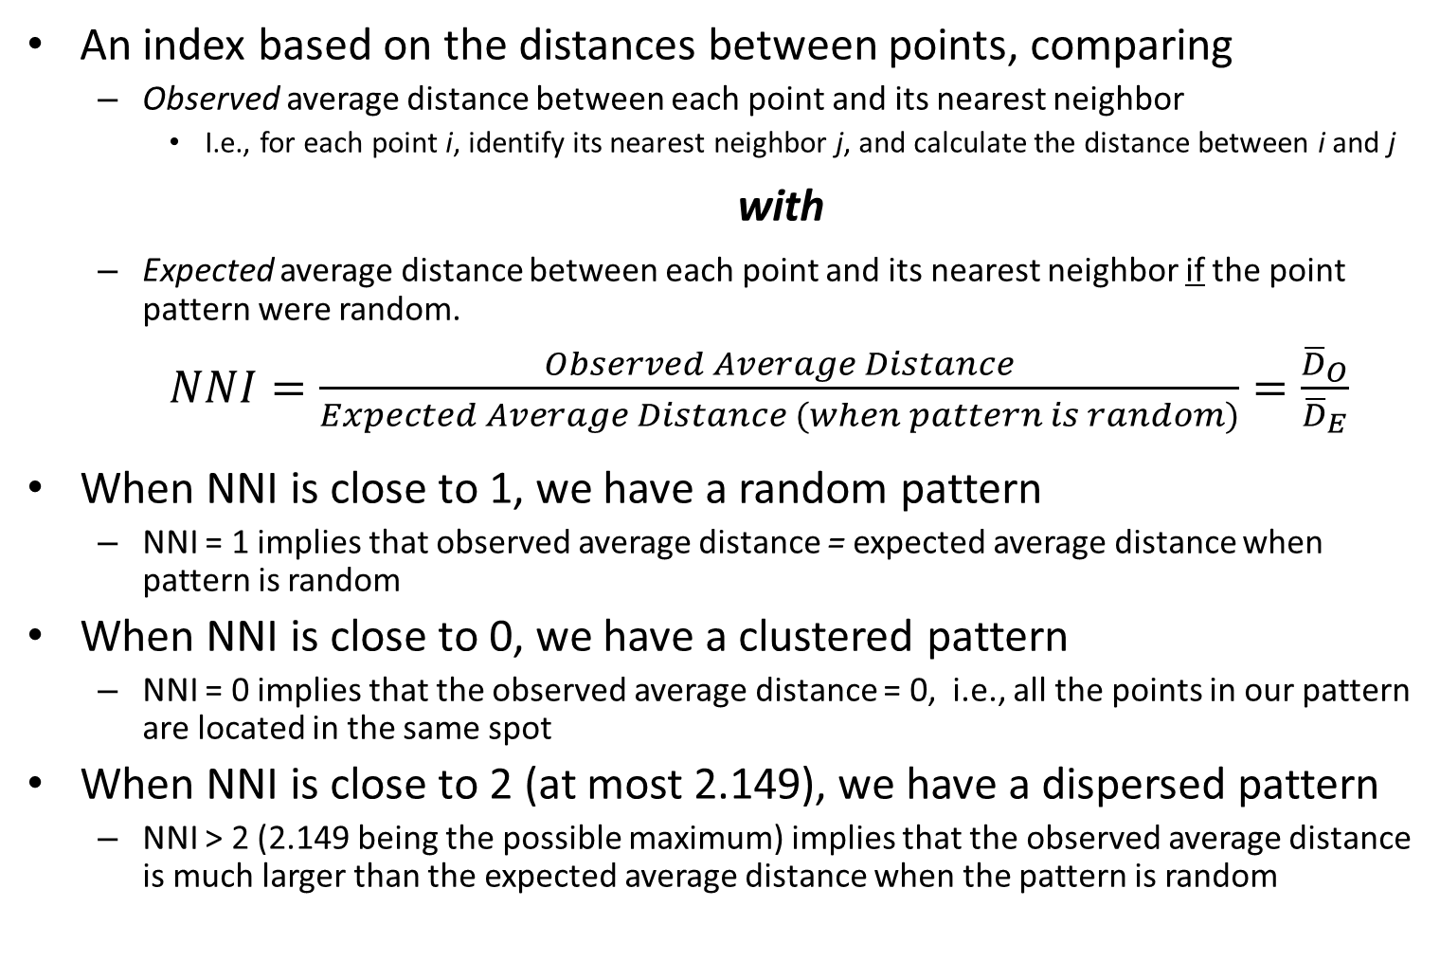
Nearest Neighbor Index (NNI)
An index based on the distances between points, comparing
Observed average distance between each point and its nearest neighbor
I.e., for each point i, identify its nearest neighbor j, and calculate the distance between i and j
with
Expected average distance between each point and its nearest neighbor if the point pattern were random.
$NNI=\frac{Observed Average Distance}{Expected Average Distance (when pattern is random)}=\frac{{\overline{D}}_{O}}{{\overline{D}}_{E}}$
When NNI is close to 1, we have a random pattern
NNI = 1 implies that observed average distance = expected average distance when pattern is random
When NNI is close to 0, we have a clustered pattern
NNI = 0 implies that the observed average distance = 0, i.e., all the points in our pattern are located in the same spot
When NNI is close to 2 (at most 2.149), we have a dispersed pattern
NNI > 2 (2.149 being the possible maximum) implies that the observed average distance is much larger than the expected average distance when the pattern is random
Notes:
It’s ok to have more than 1 nearest neighbor.

Slide 39
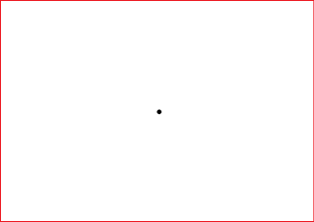
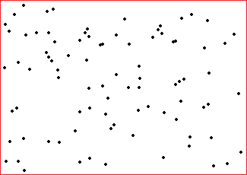
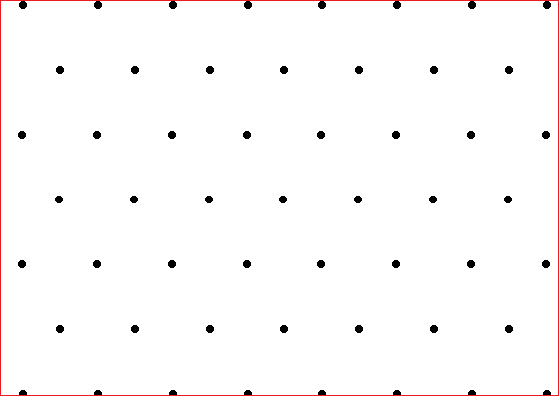
Examples of Different Values of the NNI
NNI = 0 – minimum possible value, indicating that all points are clustered at the same location (i.e., observed average distance = 0)
NNI = 1 – random point pattern, indicating that the expected average distance equals to the observed average distance
NNI = 2.149 – maximum possible value, indicating that the points are dispersed to a maximum possible extent. This happens when we have a hexagonal point pattern.

Slide 40
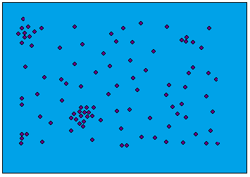
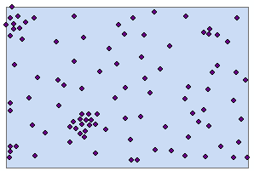
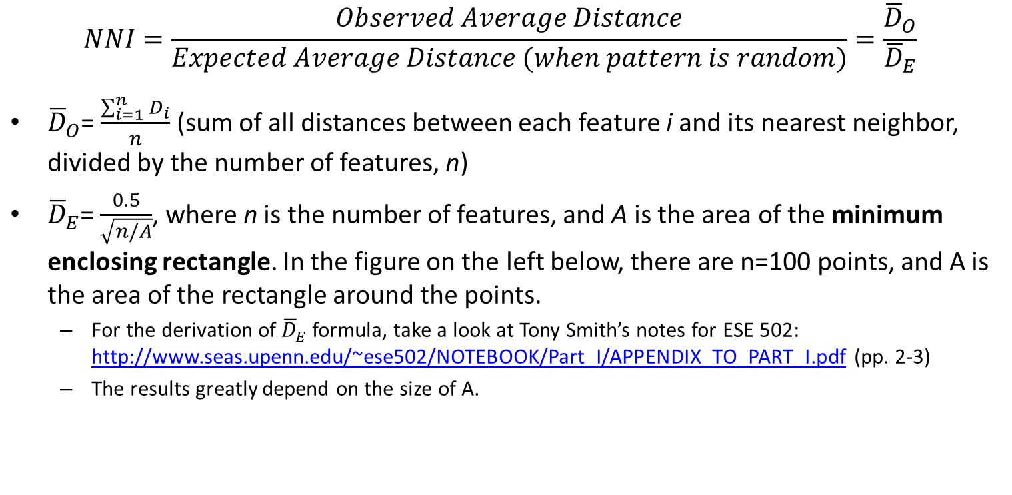
Speaking a Bit More Mathematically…
$$NNI=\frac{Observed Average Distance}{Expected Average Distance (when pattern is random)}=\frac{{\overline{D}}_{O}}{{\overline{D}}_{E}}$$
${\overline{D}}_{O}$= $\frac{\sum_{i=1}^{n}{D_{i}}}{n}$ (sum of all distances between each feature i and its nearest neighbor, divided by the number of features, n)
${\overline{D}}_{E}$= $\frac{0.5}{\sqrt{n/A}}$, where n is the number of features, and A is the area of the minimum enclosing rectangle. In the figure on the left below, there are n=100 points, and A is the area of the rectangle around the points.
For the derivation of ${\overline{D}}_{E}$formula, take a look at Tony Smith’s notes for ESE 502: http://www.seas.upenn.edu/~ese502/NOTEBOOK/Part_I/APPENDIX_TO_PART_I.pdf (pp. 2-3)
The results greatly depend on the size of A.

Slide 41
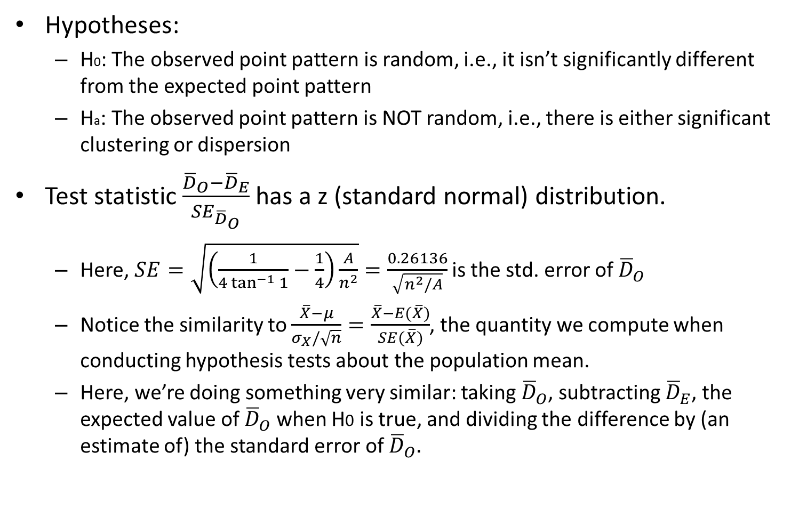
Hypothesis Testing
Hypotheses:
H0: The observed point pattern is random, i.e., it isn’t significantly different from the expected point pattern
Ha: The observed point pattern is NOT random, i.e., there is either significant clustering or dispersion
Test statistic $\frac{{\overline{D}}_{O}−{\overline{D}}_{E}}{{SE}_{{\overline{D}}_{O}}}$ has a z (standard normal) distribution.
Here, $SE=\sqrt{\left(\frac{1}{4\tan^{−1}{1}}−\frac{1}{4}\right)\frac{A}{n^{2}}}=\frac{0.26136}{\sqrt{n^{2}/A}}$ is the std. error of ${\overline{D}}_{O}$
Notice the similarity to $\frac{\overline{X}−μ}{σ_{X}/\sqrt{n}}=\frac{\overline{X}−E(\overline{X})}{SE(\overline{X})}$, the quantity we compute when conducting hypothesis tests about the population mean.
Here, we’re doing something very similar: taking ${\overline{D}}_{O}$, subtracting ${\overline{D}}_{E}$, the expected value of ${\overline{D}}_{O}$ when H0 is true, and dividing the difference by (an estimate of) the standard error of ${\overline{D}}_{O}.$
Notes:
Buyong writes 0.16136 instead of 0.26136 – it’s a typo in his book.

Slide 42
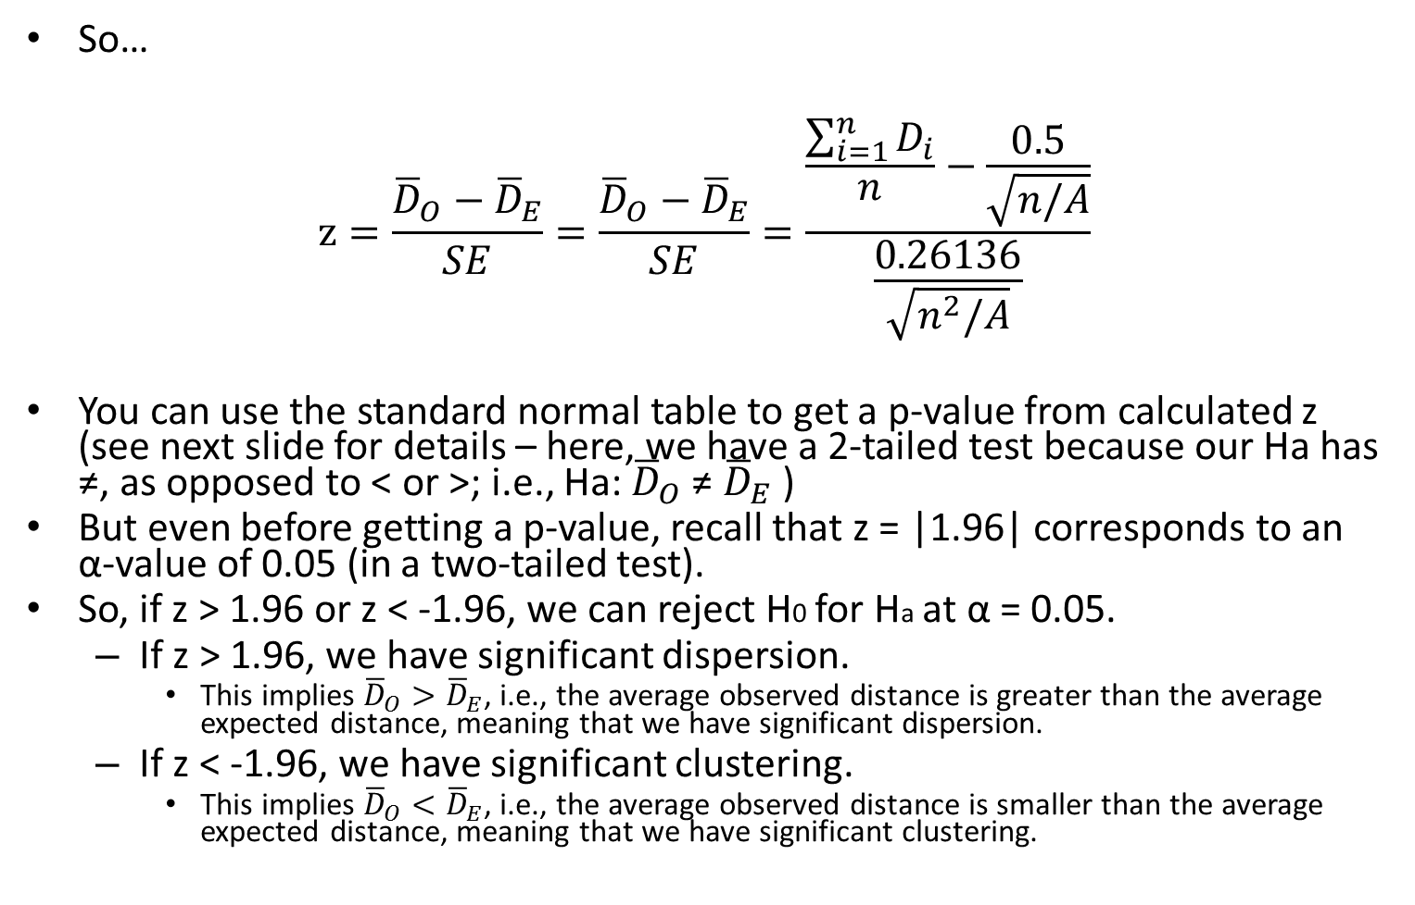
Is It Significant?
So…
$$z=\frac{{\overline{D}}_{O}−{\overline{D}}_{E}}{SE}=\frac{{\overline{D}}_{O}−{\overline{D}}_{E}}{SE}=\frac{\frac{\sum_{i=1}^{n}{D_{i}}}{n}−\frac{0.5}{\sqrt{n/A}}}{\frac{0.26136}{\sqrt{n^{2}/A}}}$$
You can use the standard normal table to get a p-value from calculated z (see next slide for details – here, we have a 2-tailed test because our Ha has ≠, as opposed to < or >; i.e., Ha: ${\overline{D}}_{O}$ ≠ ${\overline{D}}_{E}$ )
But even before getting a p-value, recall that z = |1.96| corresponds to an α-value of 0.05 (in a two-tailed test).
So, if z > 1.96 or z < -1.96, we can reject H0 for Ha at α = 0.05.
If z > 1.96, we have significant dispersion.
This implies ${\overline{D}}_{O}>{\overline{D}}_{E}$, i.e., the average observed distance is greater than the average expected distance, meaning that we have significant dispersion.
If z < -1.96, we have significant clustering.
This implies ${\overline{D}}_{O}<{\overline{D}}_{E}$, i.e., the average observed distance is smaller than the average expected distance, meaning that we have significant clustering.

Slide 43
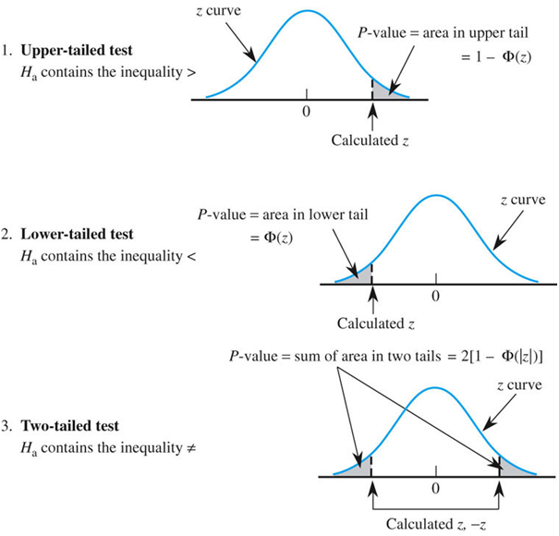
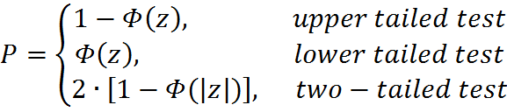
How to Get the P-Value from Standard Normal Table
(See 2-Tailed Test)
P-Values for z Tests
H0: μ = μ0; Ha: μ > μ0
H0: μ = μ0; Ha: μ < μ0
H0: μ = μ0; Ha: μ ≠ μ0
Notes:
Figure 8.7
Determination of the P-value for a z test.

Slide 44
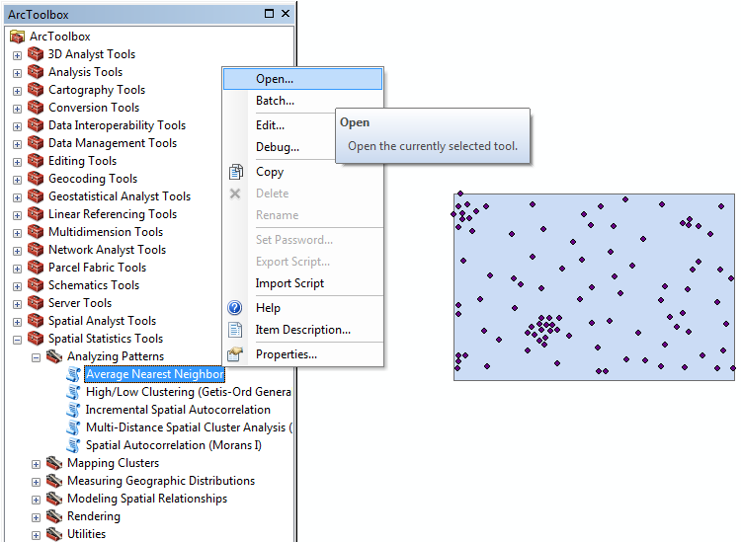
In ArcGIS…
This is our point pattern and the minimum enclosing rectangle
ArcToolbox -> Spatial Statistics Tools -> Analyzing Patterns -> Average Nearest Neighbor

Slide 45
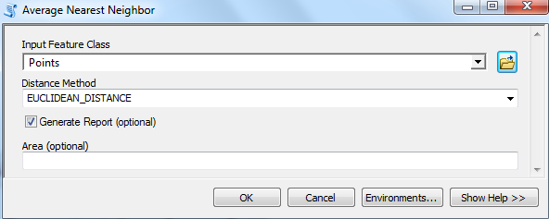
In ArcGIS…
In the Input Feature Class, put in the shapefile containing the points
In the Distance Method, select whether you want to use Euclidean or Manhattan distances between points
Check the ‘Generate Report’ option
Leave the Area field blank – by default, ArcGIS uses the minimum enclosing rectangle for the Area A.
Click OK

Slide 46
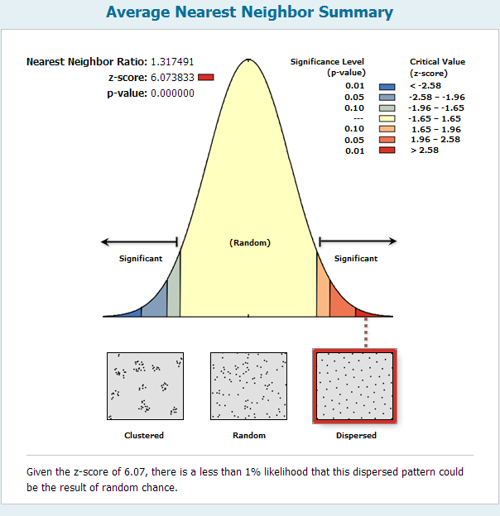
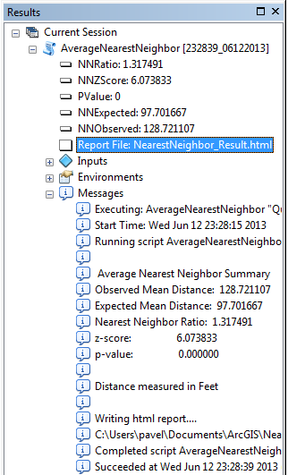
In ArcGIS…
Once it’s computed…
Go to the results window
(Geoprocessing -> Results)
Click
Compare with Quadrat Analysis Results!

Slide 47
Doing it with R
#NEAREST NEIGHBOR ANALYSIS (The data have been slightly edited from the data used in ArcGIS)
dev.off()
#Computes the distance from each point to its nearest neighbour in a point pattern.
nnd <- nndist.ppp(pp)
#Using the formulas on the slides, we calculate Mean Observed Distance, Mean Expected Distance and SE.
MeanObsDist <- mean(nnd)
#The area.owin command calculates the area of the study area that you use. Here it's the minimum enclosing rectangle, but it doesn't have to be - it could be any shapefile you import from ArcGIS (or generate in R) that corresponds to the study area.
MeanExpDist <- 0.5 / sqrt(nrow(Pts) / area.owin(BoundaryPolygonsOW))
SE <- 0.26136 / sqrt(nrow(Pts)*nrow(Pts) / area.owin(BoundaryPolygonsOW))
#Calculating the z-score
zscore <- (MeanObsDist - MeanExpDist)/SE
#Statistical test
#Here, if the z score is positive, we do an upper-tailed test and if the z score is negative we do a lower-tailed test to come up with the p-value. In our case, z=5.02 and p<0.0001
pval<-ifelse(zscore > 0, 1 - pnorm(zscore), pnorm(zscore))
#Calculating the NNI. Here, NNI = 1.26 – again, slightly different from the ArcGIS results.
NNI <- MeanObsDist / MeanExpDist

Slide 48
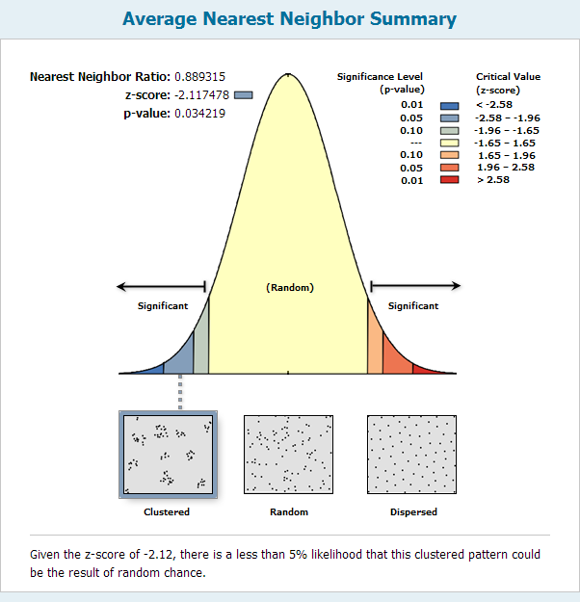
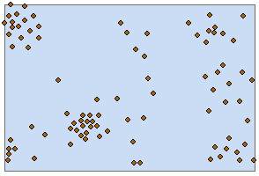
Another Point Pattern
There is some significant clustering in this pattern!

Slide 49
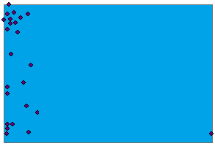
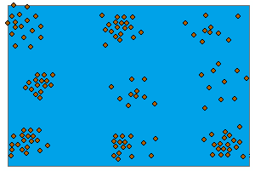
The Pros and Cons of NNI…
NNI doesn’t depend on the size of the quadrat, because it only uses the distances between points
There are still limitations, though
Takes into account average distance to only the nearest neighbor
NNI greatly depends on the value of A, the area of the study region. How do we calculate A
Minimum enclosing rectangle? (strongly affected by outliers; Figure A)
Convex hull (i.e., smallest polygon that encloses all the points)
Doesn’t take into consideration the fact that both clustering and dispersion may be present at different scales (Figure B)
A. B.

Slide 50
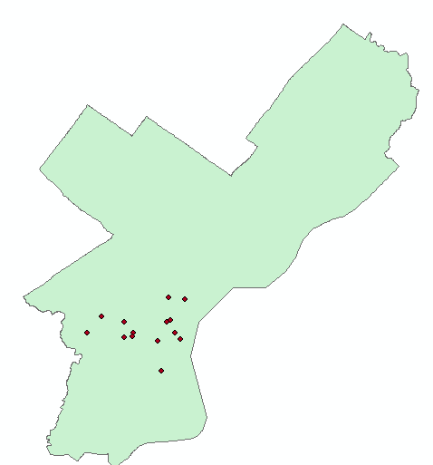
What If Your Study Area Is Irregularly Shaped?
These are locations of several hospitals in Philadelphia.
Philadelphia has an irregular (i.e., non-rectangular) shape
You can see that the hospitals are all clustered near center city
However, you cannot specify the shape of the boundary in the Average Nearest Neighbor Tool

Slide 51
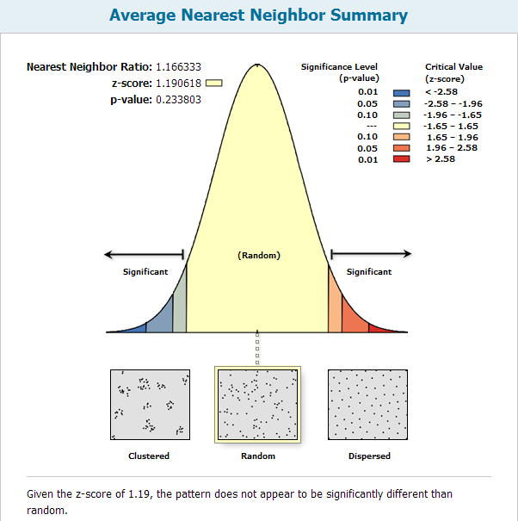
Results…
The Nearest Neighbor tool uses the blue rectangle as boundary, and not the Philadelphia outline
(Same issue with Quadrat Analysis)
Results: Random, and not clustered, pattern.

Slide 52
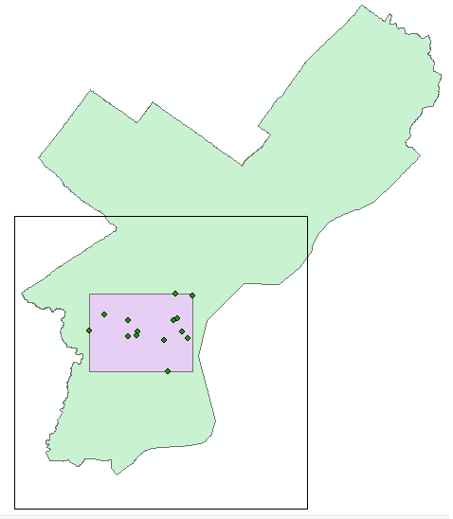
What You Can Do…
Calculate the area of Philadelphia
Input that into the NNI tool in ArcGIS
The shape of Phila won’t be taken into consideration (ArcGIS will treat it as a rectangle of that area). That is not ideal, but doesn’t matter too much.

Slide 53
Some Great Questions From Previous Years
For nearest neighbor analysis, is it possible to include the study region?
Theoretically, yes. But ArcGIS only allows you to include the area.
Their help says that even the environment settings have no effect on this tool (See http://edndoc.esri.com/arcobjects/9.2/net/shared/geoprocessing/spatial_statistics_tools/average_nearest_neighbor_spatial_statistics_.htm)
Tony Smith includes the study region in his Matlab programs
Even so, K-functions still have numerous advantages over NNI
Can you give examples of when to use the quadrat method, when to use NNI, and when to use the K-functions?
Quadrat and NNI are older methods that are traditionally covered in spatial stats courses even though nowadays, due to the limitations of these two methods, most spatial statisticians use K-functions (a newer method invented by Brian Ripley in the 1970’s)
NNI is definitely a fine way to do point pattern analysis, but has limitations
Quadrat method isn’t used too often in practice
Statisticians often like to use a couple different methods and see if their results hold.
Who is Ripley?
http://en.wikipedia.org/wiki/Brian_D._Ripley

Slide 54
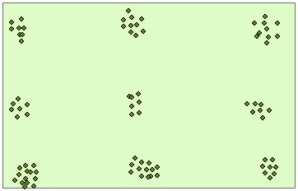
Assume We Have a Pattern Like This
Example: points are bees. Bees are clustered in hives. Hives are dispersed in space. So if you look at the spatial distribution of bees, you have clustering at small distances and dispersion at large distances.
This pattern is clustered at small distances d and dispersed at large distances d.
Said differently, we have clustering at a small scale and dispersion at a large scale.
We need a method that would enable us to detect this.
Luckily, such a method exists: Ripley's K function illustrates how spatial clustering or dispersion changes when the neighborhood size (scales) changes.

Slide 55

The Idea Behind K-Functions
Place circles, each of radius d, around every event (point).
Count the number of other events (points) inside each circle of radius d.
Calculate the average number of other events (points) in all circles of radius d.
Divide this average count of other events by the overall study area event density to get the K-function at distance d, denoted as K(d).
Repeat steps 1-4 for a range of values of d.
For instance, there are 0 other points in the green circle, 1 other point in the blue circle, and 4 other points in the red circle.

Slide 56

Determining the K function for a Pattern
Taken from O’Sullivan & Unwin
Note that some circles are outside the study region

Slide 57

In Math Speak…
$$K\left(d\right)=\frac{(\sum_{i=1}^{n}{\#[S ∈ Cirlce(s_{i},d)}])/n}{n/a}=\frac{Mean \# points in all circles of radius d}{Mean pt density in entire study region a}$$
Assume we have $n$ points in our dataset, and the area of the study region is denoted by $a$
For each point $s_{i}$, draw a circle of radius $d$ around it
Calculate the number of additional points S (i.e., points other than $s_{i}$) within each circle
Calculate the average number of points S within all circles of radius $d$ (i.e., circles of radius $d$ around all $n$ points)
Divide the average number of points by the overall point density in the study region ($n$ / $a$)
$K\left(d\right)$ is then the mean number of events you observe within a circle of radius $d$ taking into account the overall point density in the study region
That is, if we don’t take into account the overall density in the study region, we wouldn’t know if having, say, 5 points in a circle with radius $d$is a lot or a few relative to the overall point pattern.

Slide 58

When We Have Complete Spatial Randomness…
Under CSR, it turns out that ${K\left(d\right)=πd}^{2}$, or simply the area of a circle of radius $d$
${K\left(d\right)>πd}^{2}$ implies clustering at scale $d$
${K\left(d\right)<πd}^{2}$ implies dispersion at scale $d$
Recall from basic math that π ≈ 3.14
For more detail, see next slide or Tony Smith’s notes (section 4.4)
http://www.seas.upenn.edu/~ese502/NOTEBOOK/Part_I/4_K_Functions.pdf

Slide 59
More Detail About the Previous Slide
When we are dealing with a random process, the probability of the occurrence of an event (point) at any location in our study area is independent of what other events have occurred and equally likely over the whole study area. Thus, for a random process, the expected number of events within a distance d of a randomly chosen event would be just: Overall point density*area of the circle of radius d = (n/a)*πd².
But this is just the numerator of the K(d) formula!
The denominator is (n/a).
So under spatial randomness, K(d) = πd², since the (n/a) cancel out in the numerator and denominator!
Source: Bailey & Gatrell, Interactive Spatial Data Analysis,1995

Slide 60

L(d) Functions
For ease of interpretation, many statistical software packages report results in terms of L(d) functions and not K(d) functions.
Most literature, starting with Besag (1977) defines L(d) functions as transformed K(d) functions, such that for all (non-negative) distances d:
$L\left(d\right)=\sqrt{\frac{K(d)}{π}}−d$,
where π=3.14.
Here:
L(d) = 0 under CSR (recall that ${K\left(d\right)=πd}^{2}$, so $L\left(d\right)=\sqrt{\frac{K(d)}{π}}−d=$
$\sqrt{\frac{{πd}^{2}}{π}}−d=d−d=0$)
L(d) > 0 when there is clustering at scale d
L(d) < 0 when there is dispersion at scale d

Slide 61

However, ArcGIS Uses a Slightly Different Definition of L(d)
$$L\left(d\right)=\sqrt{\frac{a∙\# of points within circle of radius d (excluding point at center of circle)}{π∙n∙(n−1)}}$$
$$=\sqrt{\frac{a}{n}∙\frac{\# of points within circle of radius d (excluding point at center of circle)}{ (n−1)}∙\frac{1}{π}}$$
$$=\sqrt{\frac{\frac{\# of points within circle of radius d (excluding point at center of circle)}{ (n−1)}}{n/a}∙\frac{1}{π}} =$$
$$=\sqrt{\frac{Mean pt density at each radius d}{Mean pt density in entire area a}∙\frac{1}{π}}=\sqrt{\frac{K\left(d\right)}{π}}.$$
$$Under CSR, L(d)=\sqrt{\frac{{πd}^{2}}{π}}=d$$
L(d) > d: Clustering
L(d) < d: Dispersion
Source: http://resources.esri.com/help/9.3/arcgisengine/java/Gp_ToolRef/spatial_statistics_tools/how_multi_distance_spatial_cluster_analysis_colon_ripley_s_k_function_spatial_statistics_works.htm

Slide 62

Let’s Plot L(d) Against Distance d in ArcGIS
L(d)=d
Point Pattern in Question
ArcGIS Output
d
If K(d) or L(d) is thought of as the # of points in a circle of radius d (controlling for overall point density in the study area), then a higher than expected number of points means clustering, and lower than expected number of points means dispersion.

Slide 63

In ArcGIS
This is the
point pattern
in question

Slide 64

Select These Settings

Slide 65

ArcGIS Output
Drag table from Results Window to Table of Contents and open it

Slide 66


A Few Things About the Previous Slide
ExpectedK is really the value of the L(d) [and NOT K(d)] function we’d expect under CSR.
Recall: Under CSR, L(d) = d using the ArcGIS definition
ObservedK is the value of the L(d) function that we observe from our data
Recall: Observed L(d) computed as $\sqrt{\frac{Mean pt density at each radius d}{Mean pt density in entire area a}∙\frac{1}{π}}=\sqrt{\frac{K\left(d\right)}{π}}$
DiffK = ObservedK – ExpectedK
Note that there are 10 rows in the table: this corresponds to the number of distance bands that we set in ArcGIS.
The graph on the previous slide plots ExpectedK and ObservedK against distance d (which equals L(d) = ExpectedK)

Slide 67

Beginning and Incremental Distance and # of Distance Bands
The # of distance bands that you set is really up to you. Frequently used numbers are 10 and 20.
In the K Function Dialog Box, you can also set values for beginning and incremental distances (d).
By default, ArcGIS sets beginning distance and incremental distance to some not-very-clear values (see e-mail on next slide).
Generally, it’s good to put in values for those parameters.
The way to start is to figure out the maximum distance at which you want to do the K-function analysis.
The maximum distance that you should consider is the maximum pairwise distance between two points in your point pattern divided by 2
That is, in your point pattern, find two points that are farthest apart, and divide that distance by 2
Rounding is ok so that you can get good and round numbers (e.g., if the maximum distance is 1437, it’s ok to round up to 1500 or round down to 1400).
For beginning distance, put down 0
For incremental distance, put down the following: $\frac{\frac{1}{2}∙maximum pairwise distance}{\# of distance bands}$

Slide 68
Default Beginning and Incremental Distances
Here is the description provided by the Senior Product Engineer for this tool, explaining the calculation methods applied to obtain default values in the Beginning_Distance and Distance_Increment variables: This is the algorithm we use at version 10.1. The calculation will be slightly different at 10.2. Documentation for both 10.1 and 10.2 will be added to the Online Help in response to enhancement NIM092760: 1) We always know the Number of Distance Bands because it is a required parameter (with a default of 10). Let's call this parameter value "Iterations". We will use this value to determine the Distance Increment if one isn't provided by the user. 2) We need to calculate a "Max Distance". We initially set the Max Distance to be 25% of the maximum extent length... in 10.1 this was based on the envelope, in 10.2 it is based on the minimum enclosing rectangle. a. If the Boundary Correction method is "Reduce" we need to check that the Max Distance is larger than 50% of the minimum extent length (for 10.1 based on the envelope; for 10.2 based on the minimum enclosing rectangle) ... if it is larger than 50% of the minimum extent, we adjust the Max Distance to be 50% of the minimum extent to ensure that the study area doesn't disappear when it is reduced. b. If the Boundary Correction method isn't "Reduce", the Max Distance remains as 25% of the maximum extent length. 3) If the user doesn't provide a Distance Increment: a. If the user DID provide a Beginning Distance: i. Distance Increment = (Max Distance - Beginning Distance) / Iterations b. If the user does not provide a Beginning Distance: i. Distance Increment = Max Distance / Iterations ii. Beginning Distance = Distance Increment
Source: ESRI Customer Support, Personal Correspondence, 07/05/13

Slide 69


In This Example…
You see that the length between two points that are farthest away (using the ruler tool) is about 2500 feet.
Divide 2500 by 2 = 1250.
Assume we want 10 dist. bands.
If we set the beginning distance to 0, then the incremental distance =
$\frac{\frac{1}{2}∙maximum pairwise distance}{\# of distance bands}=$
$\frac{\frac{1}{2}∙2500}{10}=125$ ft.

Slide 70
Hypothesis Testing
H0: At distance d, the pattern is random (you have Complete Spatial Randomness at distance d)
Ha1: At distance d, the pattern is clustered
Ha2: At distance d, the pattern is uniform
What’s the test statistic here?
Turns out there isn’t one!

Slide 71

Getting at Significance
Assume you have a point pattern with n points.
Generate many (e.g., 9, 99, or 999) random point patterns with n points in each.
Calculate L(d) for the original pattern, and L(d) for each of these randomly generated patterns, using the formulas on previous slides.
Calculate L(d) for all 10 patterns
2 3 4
5 6 7
8 9 10
1
Vs.
Original Pattern 9 Generated (aka Simulated) Random Patterns

Slide 72
Getting at Significance (Cont’d)
Take the 9, 99 or 999 randomly generated patterns and for each distance d find:
The lowest value of L(d), denoted by L⁻(d) and called Lower Envelope, and
The highest values of L(d), denoted by L⁺(d) and called Upper Envelope
L⁻(d) and L⁺(d) are, respectively, the lowest and highest values of L(d) that you would expect to occur by chance (i.e., under CSR) at each particular distance d.
For each distance d, compare the observed value of L(d), denoted by L^{obs}(d), to L⁻(d) and L⁺(d)
If L⁻(d) < L^{obs}(d) < L⁺(d), then we can’t reject H0 at distance d. That is, we cannot say that at distance d, the pattern is significantly different from what we’d expect under CSR.
If L^{obs}(d) > L⁺(d), then we can reject H0 at distance d for Ha1 – that is, we have significant clustering at scale d.
If L^{obs}(d) < L⁻(d), then we can reject H0 at distance d for Ha2 – that is, we have significant dispersion at scale d.

Slide 73
Getting at Significance: Demonstration
Distance d | L(d) Values for the 10 Patterns |  |  |  |  |  |  |  |  |  | Lower Env. L⁻(d) | Upper Env. L⁺(d) | Verdict
 | Orig. L^{obs}(d) | L(d)’s for 9 Random Patterns
 | 1 | 2 | 3 | 4 | 5 | 6 | 7 | 8 | 9 | 10
Small | 45 | 30 | 32 | 36 | 21 | 28 | 40 | 23 | 25 | 30 | 21 | 40 | Sig. Clust.
Md-Small | 90 | 83 | 88 | 82 | 87 | 88 | 68 | 79 | 80 | 82 | 68 | 88 | Sig. Clust.
Medium | 135 | 143 | 131 | 144 | 157 | 123 | 132 | 138 | 142 | 128 | 123 | 157 | Random
Md-Large | 180 | 191 | 201 | 195 | 199 | 187 | 200 | 185 | 187 | 190 | 185 | 201 | Sig. Disp.
Large | 225 | 260 | 271 | 251 | 248 | 265 | 258 | 253 | 255 | 248 | 248 | 271 | Sig. Disp.
In the current example, we see the following:
L^{obs}(d) > L⁺(d) at small and medium-small distances, meaning that we have significant clustering at those scales.
L⁻(d) < L^{obs}(d) < L⁺(d) at medium distances, meaning that we have what is essentially a random pattern at that scale.
L^{obs}(d) < L⁻(d) at medium-large and large distances, meaning that we have significant dispersion at those scales.

Slide 74
Some Notes from ArcGIS Online Tutorial
Because the confidence envelope is constructed from random permutations, the values defining the confidence envelope will change from one run to the next, even when parameters are identical. If you set a seed value, however, for the Random Number Generator geoprocessing environment, repeat analyses will produce consistent results.
The number of permutations selected for the Compute Confidence Envelope parameter may be loosely translated to confidence levels: 9 for 90%, 99 for 99%, and 999 for 99.9%.
For instance, when you have 999 permutations and L^{obs}(d) < L⁻(d) at some distance d, then you can be approximately 99.9% confident that you have significant dispersion at that distance d.
Running 999 permutations may take a LONG time, depending on your computer speed, the number of distance bands, and the number of points in your original pattern.

Slide 75

Creating Confidence Envelopes in ArcGIS

Slide 76

The Output Table
Note the new fields in the output table:
LwConfEnv (this is L⁻(d)) and HiConfEnv (this is L⁺(d)).

Slide 77
The Option to Add Weights
ArcGIS gives an option to include weights in the K Function Dialog Box, i.e., run weighted K Function Analysis.
That’s useful for when each point has a value associated with it (e.g., # of crimes at that point), and we want to know where the values at each point are clustered, dispersed, or random within the given pattern of points.
We won’t be using this tool in this course, because we’ve seen other tools which do very similar things in the next couple lectures with much more widely used tools (e.g., Moran’s I).
For more info, see: http://www.nku.edu/~longa/geomed/ppa/doc/wgtkfun/wgtkfun.htm

Slide 78

What Happens to Points Next to the Border?
Assume you have some points really close to the boundary of your region, like the yellow point in the figure below. If we draw a circle of radius d around that point, about 1/2 of the circle is outside the study area, meaning that there could never be any other points in that part of the circle.
On the other hand, the circle of radius d around the blue point is entirely within the study area meaning that theoretically, there could be other points anywhere in that circle.

Slide 79
Ripley’s Edge Correction
The blue and yellow points are not comparable because of these boundary issues.
For the yellow point, instead of having that 1/2 of the circle be interpreted as part of the circle without points (i.e., 0 points), it should be interpreted as no data at all.
ArcGIS enables us to implement the so-called Ripley’s Edge Correction. Ripley's Edge Correction Formula checks each point's distance from the edge of the study area and its distance to each of its neighbors. All neighbors that are farther away from the point in question than the edge of the study area are given extra weight.
Said differently, neighboring points which are inside the study area are given extra weight to account for the fact that there could never be points in the part of the circle that’s outside the study area.
The entire blue circle is within the study area. That weight is 1. About 1/2 of the yellow circle is outside the study area, so the weight for cases within the yellow circle is 0.5.
Said differently, the case count in that area is divided by 0.5, essentially doubling the cases to account for the missing half of the circle.
Sources:
http://www.biomedware.com/files/documentation/clusterseer/Ripley/Ripleys_K_Edge_correction.htm
http://resources.esri.com/help/9.3/arcgisengine/java/Gp_ToolRef/spatial_statistics_tools/multi_distance_spatial_cluster_analysis_ripley_s_k_function_spatial_statistics_.htm

Slide 80
More On Edge Corrections (Read On Your Own)
Ripley’s edge correction works only for rectangular study regions, but there are other edge corrections in ArcGIS
The Simulate Outer Boundary Values edge correction method mirrors points across the study area boundary to correct for underestimates near edges. Points that are within a distance equal to the maximum distance band of the edge of the study area are mirrored. The mirrored points are used so that edge points will have more accurate neighbor estimates.
The Reduce Analysis Area edge correction technique shrinks the size of the analysis area by a distance equal to the largest distance band to be used in the analysis. After shrinking the study area, points found outside of the new study area will be considered only when neighbor counts are being assessed for points still inside the study area. They will not be used in any other way during the k-function calculation. This option is not valid with the user supplied study area polygon option for the Study Area parameter.
Points in the input feature class that fall outside the user specified study area are only considered when the "None" edge correction option is selected.
Source: http://resources.esri.com/help/9.3/arcgisengine/java/Gp_ToolRef/spatial_statistics_tools/multi_distance_spatial_cluster_analysis_ripley_s_k_function_spatial_statistics_.htm

Slide 81

Now Let’s Take a Real World Example
Assume we want to look at the distribution of n=260 hospitals in PA. We will obtain the data from PASDA (Pennsylvania Spatial Data Access) website maintained by Penn State University
http://www.pasda.psu.edu/
Questions: Are the hospitals clustered in PA?
Any guesses based on the visual pattern?

Slide 82

Let’s Do it in ArcGIS!
Here, 250,000 is half the maximum pairwise distance between points. Since we set the # of distance bands to 10 and the beginning distance to 0, the distance increment is 250,000/10.
PA is the shapefile of Pennsylvania.
We use 99 permutations and Simulate Outer Boundary Values Boundary Correction.
Our results will be saved in the file K_Orig_Pattern.dbf.
And we want to display our results
graphically.

Slide 83

ArcGIS Results
You see clustering at small and medium distances, and a bit of dispersion at larger distances. Note the blue line is outside the envelope for large distances because of edge effects, regardless of whether we correct for them.

Slide 84

Doing it with R
#Reading Polygon Boundary.shp from the directory above
Boundary <- readShapePoly("PA_Albers.shp")
#Class "SpatialPolygons" holds polygon topology (without attributes)
BoundaryPolygons <- as(Boundary, "SpatialPolygons")
#The class "owin" is a way of specifying the observation window for a point pattern.
BoundaryPolygonsOW<- as(BoundaryPolygons, "owin")
#Plotting the Boundary Window
title(main = "Point Pattern Analysis")
plot(BoundaryPolygonsOW)
#Reading in the file with the points
Pts <- read.table("Hospitals_for_R.txt", header=T, sep="\t", colClasses = c("X"="double"))
pp <- ppp(Pts$X, Pts$Y, window=BoundaryPolygonsOW)
#Now let's plot the points and the Boundary
plot(pp,add=T)
title(main = "Point Pattern Analysis")

Slide 85

Doing it with R (Cont’d)
#K-Functions
#Double click on the khat data set. It will have 513 observations and 5 variables. We are interested in 2 variables:
#-- r, which is the distance that goes in increments of 138.8693
#-- iso, which is the k-function calculated with
Ripley's edge correction
khat <-Kest(pp) , rmax=250000)
#Plots K function calculated with Ripley’s isotropic edge correction, line width 2, axis labels, and title.
plot(khat$r,khat$iso,xlab="r", ylab="Ripley’s K",
main="Ripley’s Estimated K-Function",
cex.lab=1.6,cex.axis=1.5,cex.main=1.5,lty=1,lwd=2)
# Overlays the theoretical K-function under CSR
with a dashed (lty=8) line.
lines(khat$r,khat$theo,lty=8, lwd=2)
#Computes confidence envelopes using n=199 simulations. Here, nrank=1 means we're looking at the lowest and highest values of the simulated envelopes. Here, alpha = 2 * nrank/(1 + nsim) = 2*1/200 = 0.01
#spatstat::envelope is to specify that the envelope command is in the spatstat library and not the boot library.
Kenv <- spatstat::envelope(pp,fun="Kest", rmax=250000, nsim=199, nrank=1)
# Plots Ripley’s K function with 99% simulation # envelopes, axis labels, and a title.
plot(Kenv,xlab="r",ylab="Khat(r)", cex.lab=1.6,cex.axis=1.5,main=
"Ripley’s Khat with Confidence Envelopes",cex.main=1.5,lwd=2)

Slide 86

Doing it with R (Cont’d)
#L-Functions
lhat <- Lest(pp, rmax=250000)
#Plots L function with line width 2, Ripley’s isotropic edge correction, axis labels, and title.
plot(lhat$r,lhat$iso-lhat$r, xlab="r",ylab="Ripley’s L",cex.lab=1.6,
cex.axis=1.5,cex.main=1.5,lty=1,lwd=2, main="Ripley’s Estimated L-Function")
#Overlays the theoretical L-function under CSR with a dashed (lty=8) line.
lines(lhat$r,lhat$theo-lhat$r,lty=8,lwd=2)
#Code to compute the Ripley’s Simulation Confidence Envelopes
#Computes confidence envelopes using n=199 simulations. Here, nrank=1 means we're looking at the lowest and highest values of the simulated envelopes. Here,
alpha = 2 * nrank/(1 + nsim) = 2*1/200 = 0.01
Lenv <- spatstat::envelope(pp,fun="Lest", rmax=250000, nsim=199,nrank=1)
# Plots Ripley’s L function with 99% simulation envelopes, axis labels, and a title.
plot(Lenv,xlab="r",ylab="Lhat(r)", cex.lab=1.6,cex.axis=1.5, main= "Ripley’s Lhat with Confidence Envelopes“, cex.main=1.5, lwd=2,legend=F)

Slide 87

Doing it with R (Cont’d)
#A better way to view this is to rotate this plot 45 degrees clockwise.
#Gives the Ripley’s data frame a new name L2.
L2 <- Lenv
#Now we will subtract the distance r from the R-defined Ripley's L's
#(This will be done for the observed L, theoretical L, lower and uper envelopes)
L2$obs <- L2$obs-L2$r
L2$theo <- L2$theo-L2$r
L2$lo <- L2$lo-L2$r
L2$hi <- L2$hi-L2$r
# Plots Ripley’s L function with 99% simulation envelopes, axis labels, and a title.
plot(L2,xlab="r",ylab="Lhat(r)", cex.lab=1.6,cex.axis=1.5,
main= "Ripley’s Lhat with Confidence Envelopes",cex.main=1.5,lwd=2,legend=F)
#Key finding: ArcGIS and R results are consistent!

Slide 88

What if Clustering We Observe Is Simply Due to Higher Population in Clusters?

Slide 89


A Different Look
Hospitals are generally located near population centers. That is, it wouldn’t make much sense to put a hospital in an area where no one lives.
So let’s look at our point pattern one more time, this time with a shapefile of PA county population

Slide 90
Our K-function Analyses Didn’t Take Population Into Consideration!
When we do a statistical test, our original sample is being compared to 9, 99, or 999 randomly generated point patterns.
That is, these 9, 99, or 999 patterns are generated without taking into consideration the population density of the different counties, resulting in inappropriate comparisons!
Ideally, we would want to compare our actual pattern of 260 hospitals to 9, 99 or 999 generated patterns that take into consideration the population throughout the state.
Notes:
Density – because if we only consider population, then bigger counties will have more points.

Slide 91

Where There’s a Will, There’s a Way!
Turns out that ArcGIS has a function called Create Spatially Balanced Points
It’s part of the Geostatistical Analyst extension, so be sure to have the extension turned on.
The tool generates a set of sample points based on a raster that shows “inclusion probabilities”.
In practice, we can reclassify the population raster to be such a probability raster
The reclassified population raster would have values ranging between 0 and 1
Generated points would be less likely to land where probability raster values (i.e., population values) are lower, and more likely to land in locations where probability raster values (i.e., population values) are higher.

Slide 92

First Step
Take our polygon shapefile that contains population values and use some mathematical operation to convert population values to probabilities (values between 0 and 1)
Again, higher population values should correspond to higher probabilities
One way to do this would be to divide the population in each county by the maximum population value in the data set (1448394 in this case)
This way, counties where population is really low (e.g., 5489) would have a very low associated probability (of a point landing in it) and counties where population is really high (e.g., 1448394) would have a very high associated probability (of a point landing in it).
We do this calculation in the attribute table of the population shapefile

Slide 93

In ArcGIS…
Now that we’ve created the variable PopProb (which has possible values within the [0,1] interval), we can convert this variable to raster.
If PopProb in a county is, say, 0.35, then in the raster file, each pixel within that county will have a value of 0.35.

Slide 94

Let’s Convert Our County-Level Shapefile to Raster Format
In ArcGIS, go to ArcToolBox -> Conversion Tools -> To Raster -> Polygon to Raster.
In Input Features, put in the county shapefile.
In Value Field, select the field that corresponds to population density (PopProb). That is, each pixel in the resulting raster will equal to the population of the county in which that pixel is located.
In Output Raster Dataset, come up with an appropriate name for your raster (probraster is good enough)

Slide 95

Here’s the Result
Note: Make higher values darker

Slide 96

Now, Let’s Generate Points
In ArcToolbox, go to Geostatistical Analyst Tools -> Sampling Network Design -> Create Spatially Balanced Points
Here, we input 260 points, because that’s the number of hospitals in our original point shapefile.

Slide 97

Here’s the Resulting Point Pattern
The point shapefile ProbPts.shp that we generated on the previous slide is shown here.
Note that darker areas (greater population density) have more points and lighter areas (lower population density) have fewer points

Slide 98
Repeat This Point Generating Process 9, 99 or 999 Times
Do the menial task of generating 9, 99 or 999 patterns
For each one of these 9, 99 or 999 generated patterns, calculate the L(d) function in ArcGIS, (without random envelopes)
For each distance d, compare L(d) of our original, observed pattern to the L(d) of these generated patterns.

Slide 99


Original Pattern 9 Generated Patterns using the Generate Spatially Balanced Points Tool

Slide 100

Calculate L(d) For Each Pattern
In Input Feature Class, put in the shapefile (actual point pattern and each of the 9 generated patterns, in turn)
Under Compute Confidence Envelope select 0 Permutations (you’re using the patterns generated with Spatially Balanced Points tool for comparison with your original pattern)
Select the Simulate Outer Boundary Values Boundary Correction and the PA Shapefile as the study area boundary.

Slide 101


Examine The Resulting Output Tables
Join the output tables for each of the 10 point patterns by distance – that is, by the ExpectedK field (can be done in ArcGIS or in Excel)
DOH_Hospitals is the output table for the original pattern; Hawths1a – Hawths9a are the output tables for the 9 patterns generated in Spatially Balanced Points Tool.
The tables look like this:
ObservedK is the field of interest. Feel free to remove the OID, Field1 and DiffK fields prior to joining tables.

Slide 102
Merging (Joining) The Resulting Output Tables
ExpectedK (Distance d) | L(d)'s for Observed and Generated Patterns
 | DOHHospitals_ L^{obs}(d) | Hwths1 | Hwths2 | Hwths3 | Hwths4 | Hwths5 | Hwths6 | Hwths7 | Hwths8 | Hwths9 | Lower Env. L⁻(d) | Upper Env. L⁺(d) | Verdict
25000 | 59861 | 38400 | 40238 | 41747 | 38799 | 40948 | 40488 | 34162 | 39268 | 40178 | 34162 | 41747 | Clustered
50000 | 91368 | 78125 | 79994 | 81432 | 76229 | 76913 | 79347 | 68485 | 77206 | 76085 | 68485 | 81432 | Clustered
75000 | 116799 | 111659 | 113120 | 116088 | 110427 | 112793 | 108775 | 102213 | 110930 | 108320 | 102213 | 116088 | Clustered
100000 | 143009 | 141621 | 141581 | 144621 | 139352 | 142296 | 137667 | 130365 | 139214 | 136190 | 130365 | 144621 | Random
125000 | 164375 | 166981 | 162950 | 169302 | 163132 | 164911 | 164713 | 157355 | 162107 | 159427 | 157355 | 169302 | Random
150000 | 187219 | 189228 | 180404 | 189595 | 183128 | 187000 | 187449 | 182010 | 184580 | 181341 | 180404 | 189595 | Random
175000 | 210076 | 207145 | 195831 | 210090 | 200383 | 206588 | 212537 | 203254 | 203111 | 200222 | 195831 | 212537 | Random
200000 | 224009 | 221536 | 209503 | 222437 | 215367 | 221561 | 224293 | 220280 | 218883 | 215031 | 209503 | 224293 | Random
225000 | 236099 | 234161 | 221913 | 235960 | 229691 | 234925 | 239290 | 234889 | 232663 | 228292 | 221913 | 239290 | Random
250000 | 247240 | 246004 | 233920 | 247799 | 242472 | 247255 | 251777 | 247259 | 244305 | 239447 | 233920 | 251777 | Random
The pattern is clustered at small distances, and random at all the larger distances.
Compare this table with what we got when we ran the permutations in ArcGIS

Slide 103
Comparing with Earlier Output
When you don’t take population into consideration (graph on the left), you have clustering at small and medium distances. When you do take population into consideration (as on previous slide), there is clustering only at small distances.

Slide 104
To Sum It All Up…
K-function Analysis has Quadrat Analysis and Average Nearest Neighbor Analysis beat!
No dependence on quadrat size
Analysis at different distances (scales)
Taking population density into consideration
Taking into consideration irregularly shaped study areas (i.e., doesn’t assume a rectangular study area)

Slide 105
Prior to ArcGIS 10.1 SP1
A couple years ago, when students would run the same K-function analysis on different computers, they would occasionally get drastically different results.
After several months of communicating with ESRI, it turned out that before ArcGIS 10.1 Service Pack 1, the random envelopes were generated incorrectly.
That is, prior to 10.1 SP1, the extent that was used for generating the 999 random point patterns that were used to construct the envelopes was the extent of our input points (hospitals) and not our study area (Pennsylvania), as it should have been. That certainly produced some pretty funky (read: WRONG) results.
#YouHadOneJob

Slide 106

Earlier Versions of ArcGIS
The ExpectedK function is outside the confidence envelope, even at small distances.
This makes no sense!
The reason is that the envelopes are generated incorrectly before ArcGIS 10.1 SP1

Slide 107
Coordinate Systems
Using projected data is always recommended for Point Pattern Analyses (just like with spatial autocorrelation and spatial regression analyses)
That is, use a projected coordinate system (based on feet, meters, etc.) and NOT a geographic coordinate system, that is based on degrees, minutes and seconds.
If your shapefile is in a geographic coordinate system, or if it has unknown units, project it:
For instance, for a Philadelphia shapefile that has unknown units, take the following steps:
ArcToolBox -> Data Management Tools -> Projections and Transformations -> Define Projection. Select your shapefile, and under the coordinate system, navigate to Geographic Coordinate Systems -> North America -> NAD 1983, and click OK
Now that you have defined your coordinate system, let’s project it: ArcToolBox -> Data Management Tools -> Projections and Transformations -> Feature -> Project. Select shapefile, select the name and location of the output shapefile, and under the output coordinate system, navigate to Projected Coordinate Systems -> State Plane -> NAD 1983 (US Feet) -> NAD 1983 StatePlane Pennsylvania South FIPS 3702 Feet and click OK.
In a new map document, open the output shapefile, and work with that shapefile instead.
Depending on the situation, you may need to only define a projection, or only do the projection (i.e., do only one of the steps above).
FYI: What your favorite map projection says about you: http://xkcd.com/977/ ☺

Slide 108
Some Additional Things You Would Learn in ESE 502
The in-depth mathematics behind all the methods presented
More about the assumptions behind each method
Implementation of all these methods in Matlab (substantially better than ArcGIS)
Cross K-Functions: A tool which examines whether two point patterns are independent of each other at various distances
I.e., are wolves and rabbits (who are hunted by wolves) clustered in the same areas, independent of each other, or repelled by each other.

Slide 109

What Would Happen If We Had a Randomly Generated Pattern?
Basically, in the probsurf field, we put in FALSE, meaning that
pixel values representing population (or population density) in counties are not taken into consideration here, so more dense counties don’t have more points.

Slide 110

Randomly Generated Pattern
Pixel values representing population (or population density) in counties are not taken into consideration here, so more dense counties don’t have more points.

Slide 111

Subject Point Pattern to K-Function Analysis
The observed K-function is within the random envelopes for all distances. The Expected K-function is within the envelopes for small distances, but outside the envelopes for larger distances (despite edge corrections)

Slide 112

K-Functions Using Network Distances
Instead of drawing circles of radius d around each point, draw shapes that show a distance of d in all directions from a point if traveled along a road network
Read more at: http://www.ncbi.nlm.nih.gov/pmc/articles/PMC1470469/
Image shamelessly stolen from: http://donovanbloggis.blogspot.com/

Slide 113

Clustering in 3 Spatial Dimensions
What if you were looking at points in 3 dimensions?
Instead of drawing circles of radius d, we draw spheres of radius d. Everything else remains the same.

Slide 114

Non-Spatial Cluster Analysis
Income
Education
Debt
Source: http://apandre.files.wordpress.com/2011/08/clusterdistances.jpg

